Slide 1
Microsoft Azure Stream Analytics Technical Briefing

Slide 2
Event Processing Azure Stream Analytics
Notes:
Event Processing – Azure Stream Analytics.

Slide 3
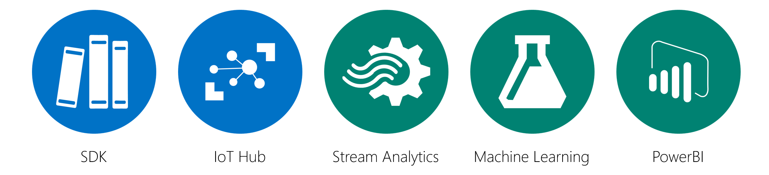
Real time event processing
Uncover real time insights
Perform real time analytics across multiple streams
Rapid Deployment
Use simple SQL syntax, auto distributed for scale
Mission critical reliability
Fully managed, low latency, high throughput
Create real time alerts
Flag alerts and alarms for attention
High volume
Analyze millions of data points per second
Highly scalable
Enterprise grade, predictable solution
Notes:
ASA can not only handle millions of events per second but it can also correlate across multiple independent streams of data simultaneously. This high speed event processing allows for the real time detection of anomalies or escalations based on threshold breaches or alarm settings as the data is ingested. The architecture is simple and easily scalable to an enterprise ready solution.
Azure Stream Analytics:
Real time analytics
Millions of events per second
Low latency, high througput

Slide 4
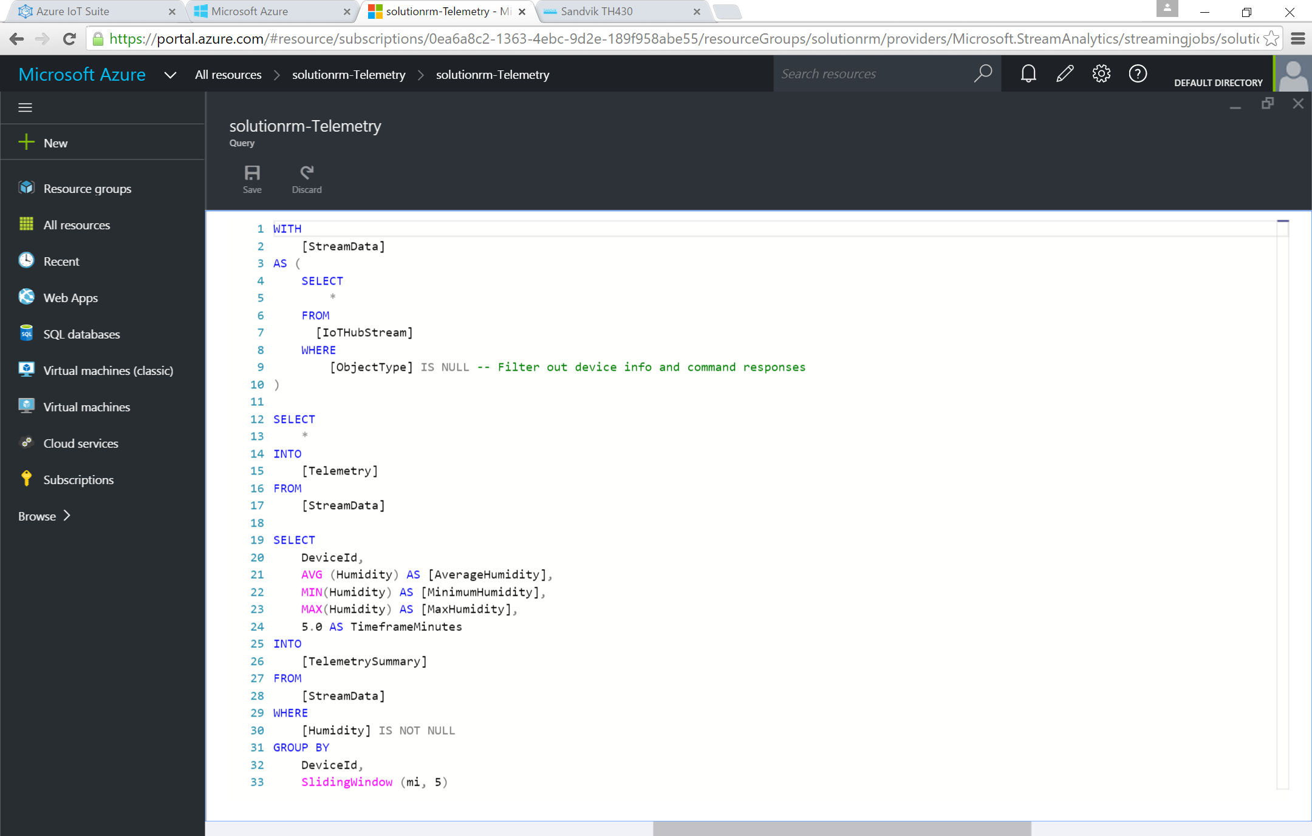
Add or edit jobs using simple ASA interface
Rule based interface
Simple implementation and rule development using ASA UI
Multi-channel
Analyze multiple channels of information simultaneously, in real time
Notes:
Utilize the simple ASA rule based interface within the Azure Management Portal to create, manage and control rules.
Azure Stream Analytics:
Simple interface for rule development and management

Slide 5
Demonstration and Discussion
Consumer Groups
Partitions for application / service consumption. Limited to 6 “consumers” per group.
Components
Inputs (show)
Outputs (show)
Query
Functions, both ML and JavaScript
Built in Functions
Math, Array, Date/Time, Conversion, Geospatial, String, Record, Lag
External Functions
JavaScript (UDF)
Azure Machine Learning
Windowing
Tumbling Window (non overlapping)
Hopping Window (overlapping)
Sliding Window (changes only)
Notes:
ASA can not only handle millions of events per second but it can also correlate across multiple independent streams of data simultaneously. This high speed event processing allows for the real time detection of anomalies or escalations based on threshold breaches or alarm settings as the data is ingested. The architecture is simple and easily scalable to an enterprise ready solution.
Azure Stream Analytics:
Real time analytics
Millions of events per second
Low latency, high througput

Slide 6

© 2014 Microsoft Corporation. All rights reserved. Microsoft, Windows, Windows Vista and other product names are or may be registered trademarks and/or trademarks in the U.S. and/or other countries.
The information herein is for informational purposes only and represents the current view of Microsoft Corporation as of the date of this presentation. Because Microsoft must respond to changing market conditions, it should not be interpreted to be a commitment on the part of Microsoft, and Microsoft cannot guarantee the accuracy of any information provided after the date of this presentation. MICROSOFT MAKES NO WARRANTIES, EXPRESS, IMPLIED OR STATUTORY, AS TO THE INFORMATION IN THIS PRESENTATION.

